Slide 1

BIBLE STUDY
CALLED TO BE FAITHFUL:
THE COMMANDMENTS OF GOD

Slide 2
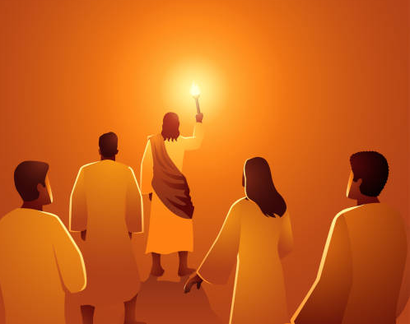
Introduction
Christ’s followers are called to be faithful. Faithfulness is a property of a relationship. As believers, we are in a relationship with God, and this relationship is the basis for our call to faithfulness.

Slide 3

Our faithfulness must begin with acknowledging God for who He is and what He has done for us.
We can depend on God because He created us and has redeemed us out of love.
He is reliable and faithful (Lam 3:23-24; 1 Cor 1:9).
And He is true (1 John 5:20). Truth is an attribute of the Father, Son, and Holy Spirit (John 8:26; 14:6; 1 John 5:6).

Slide 4
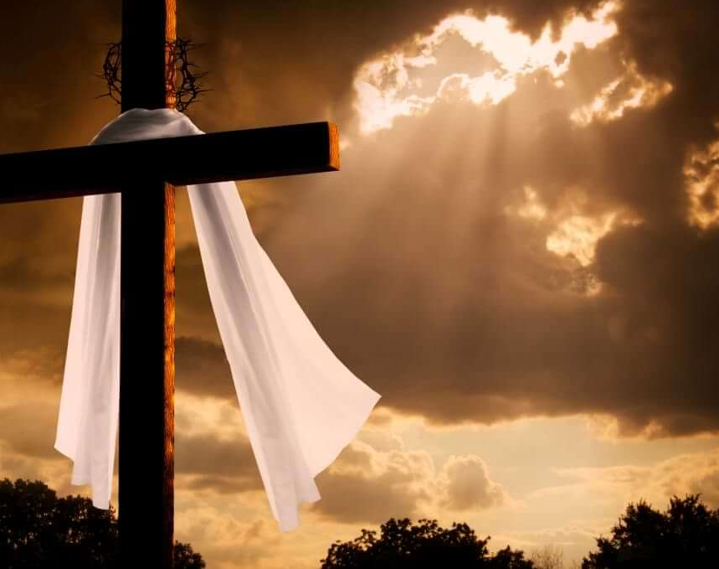
Knowing that God is almighty, true, and faithful, we are ready to trust Him and do His will. The Bible informs us that God loved the world so much that He sacrificed Himself through His Son and has invited us to believe in the Son to receive eternal life (John 3:16).

Slide 5
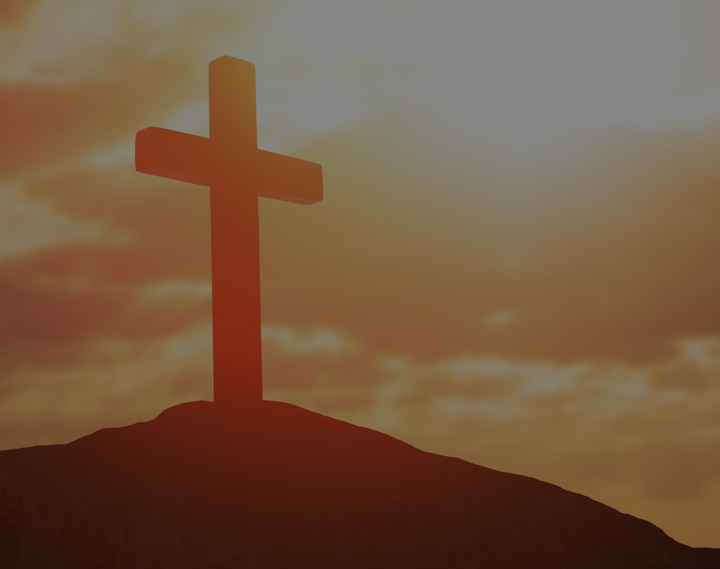
Those who accept Christ as Lord and Saviorentera covenant relationship with God that is regulated through divine commands, which are the expression of His will.
Thus, we keep the commandments not to be saved but because we are saved and are being saved by grace through faith (Eph 2:8-10).

Slide 6
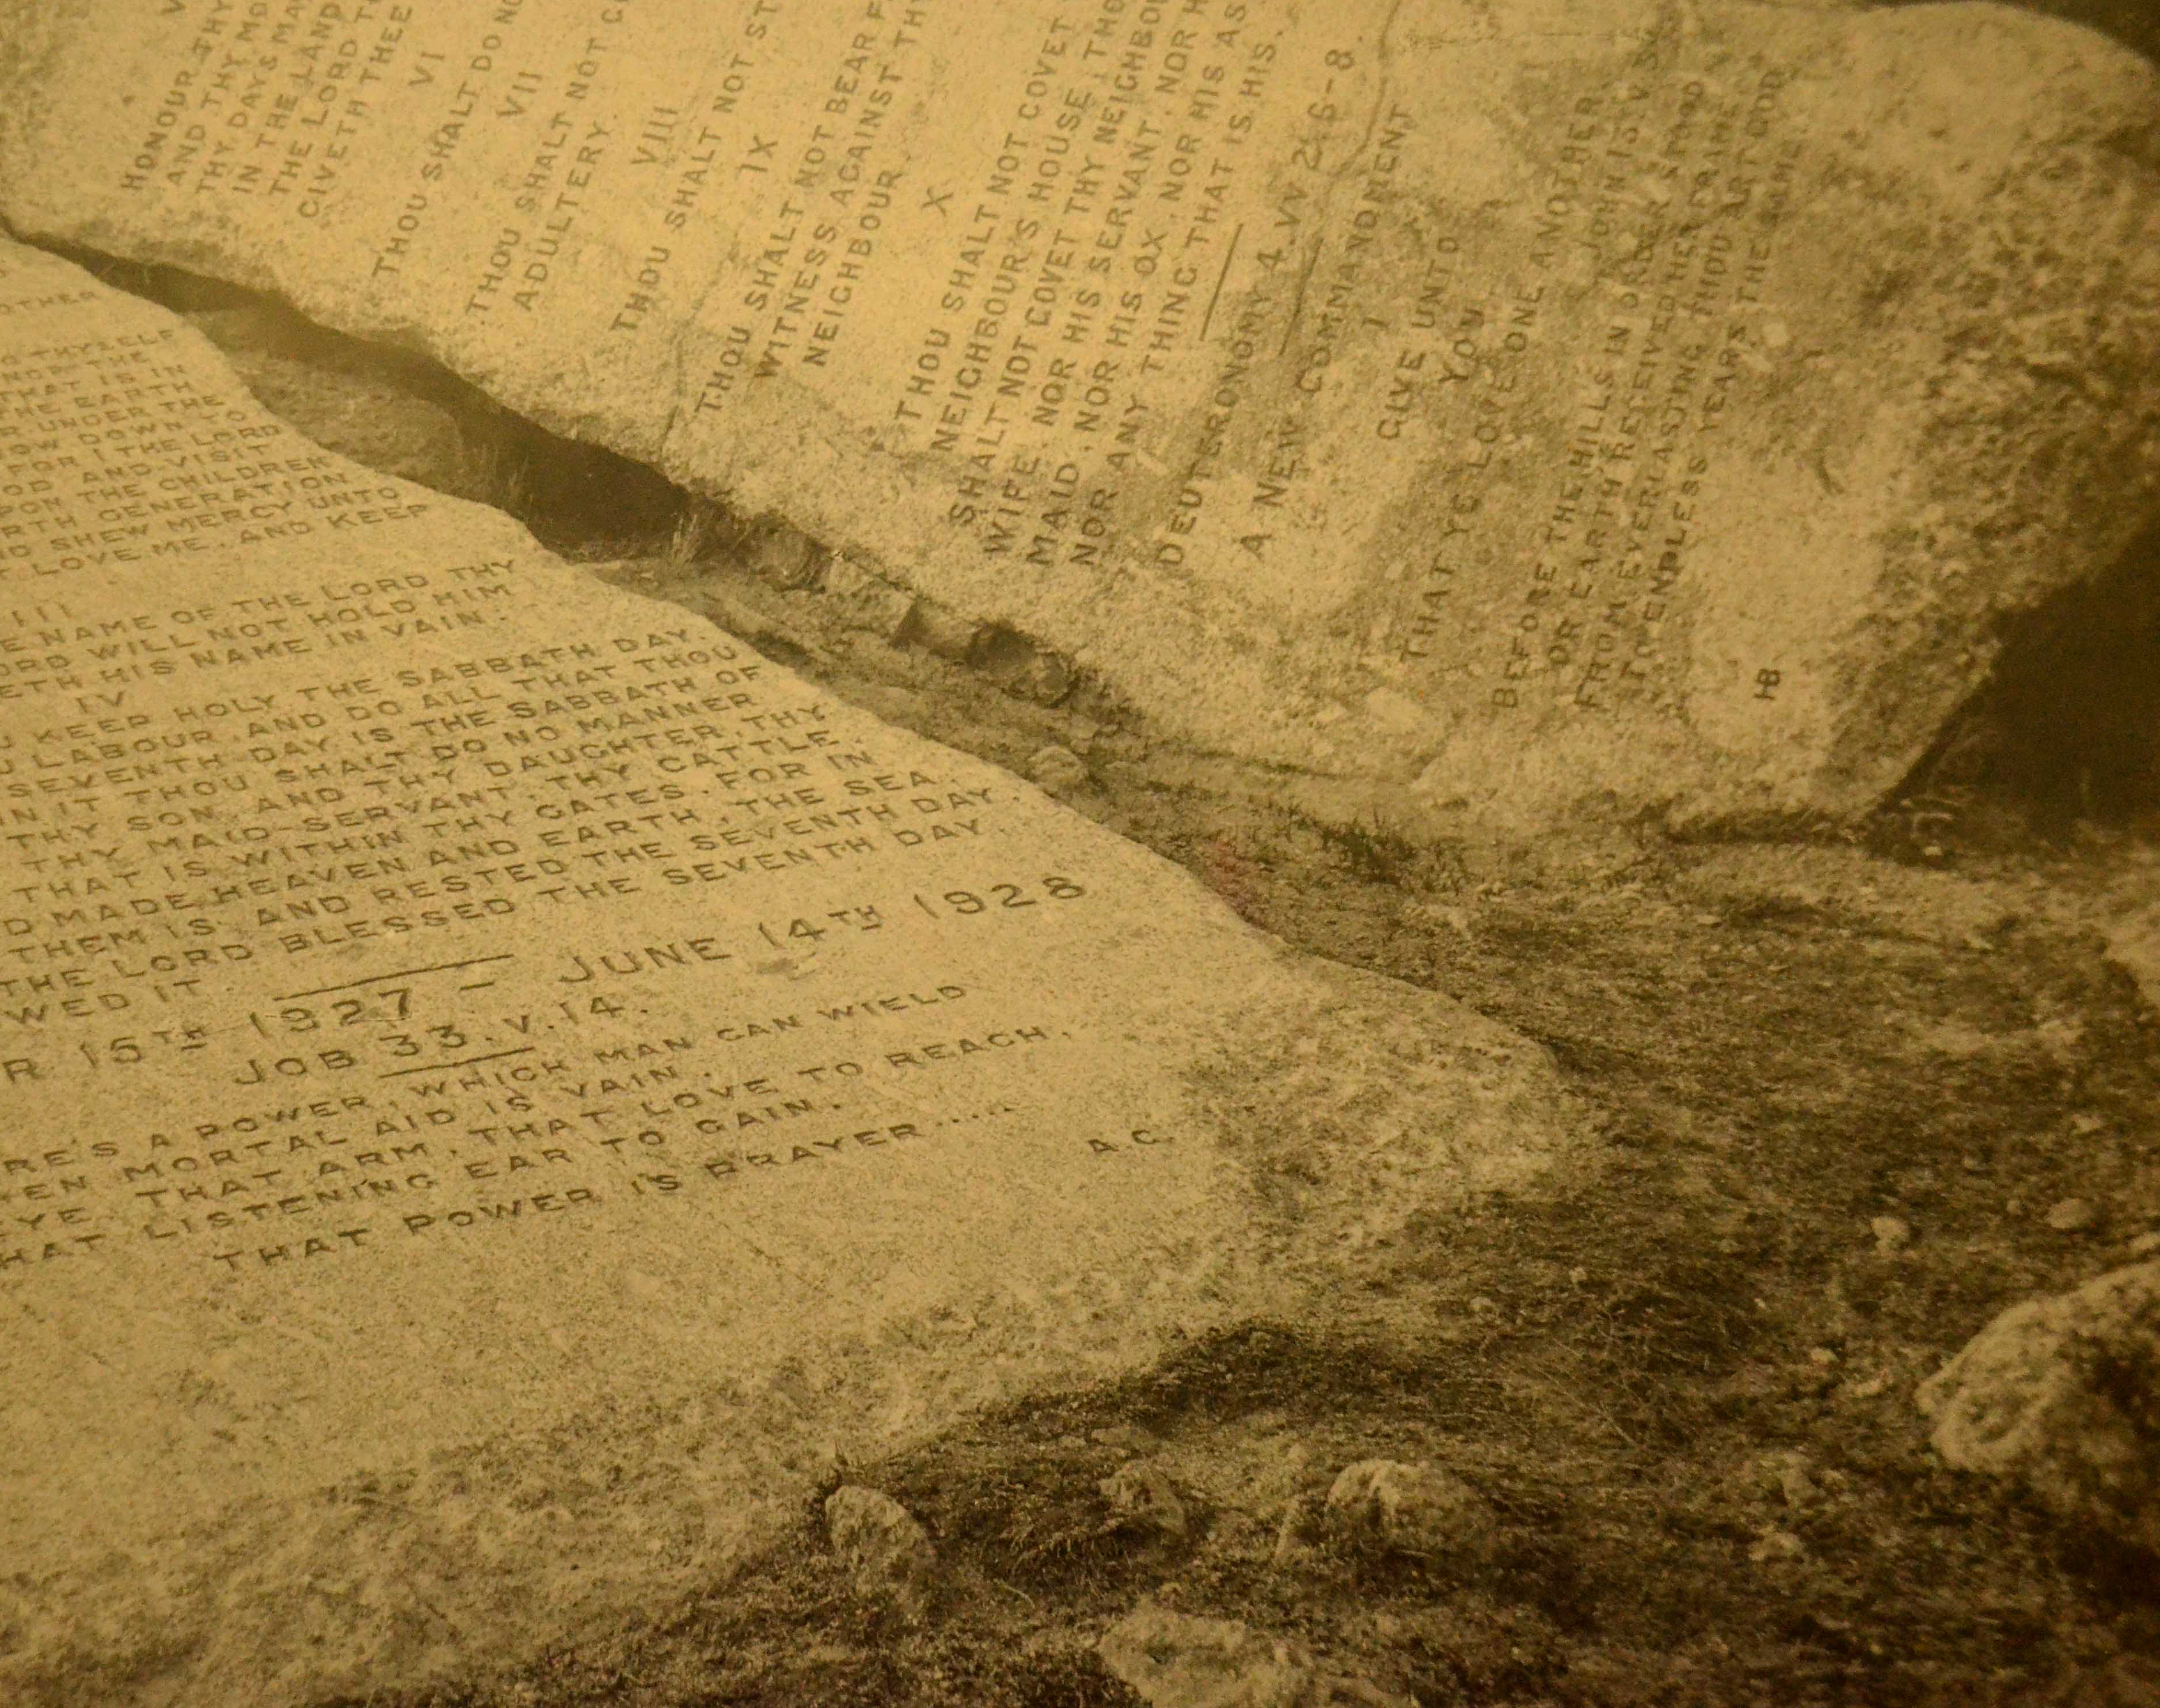
COMMANDMENTS OF GOD.

Slide 7
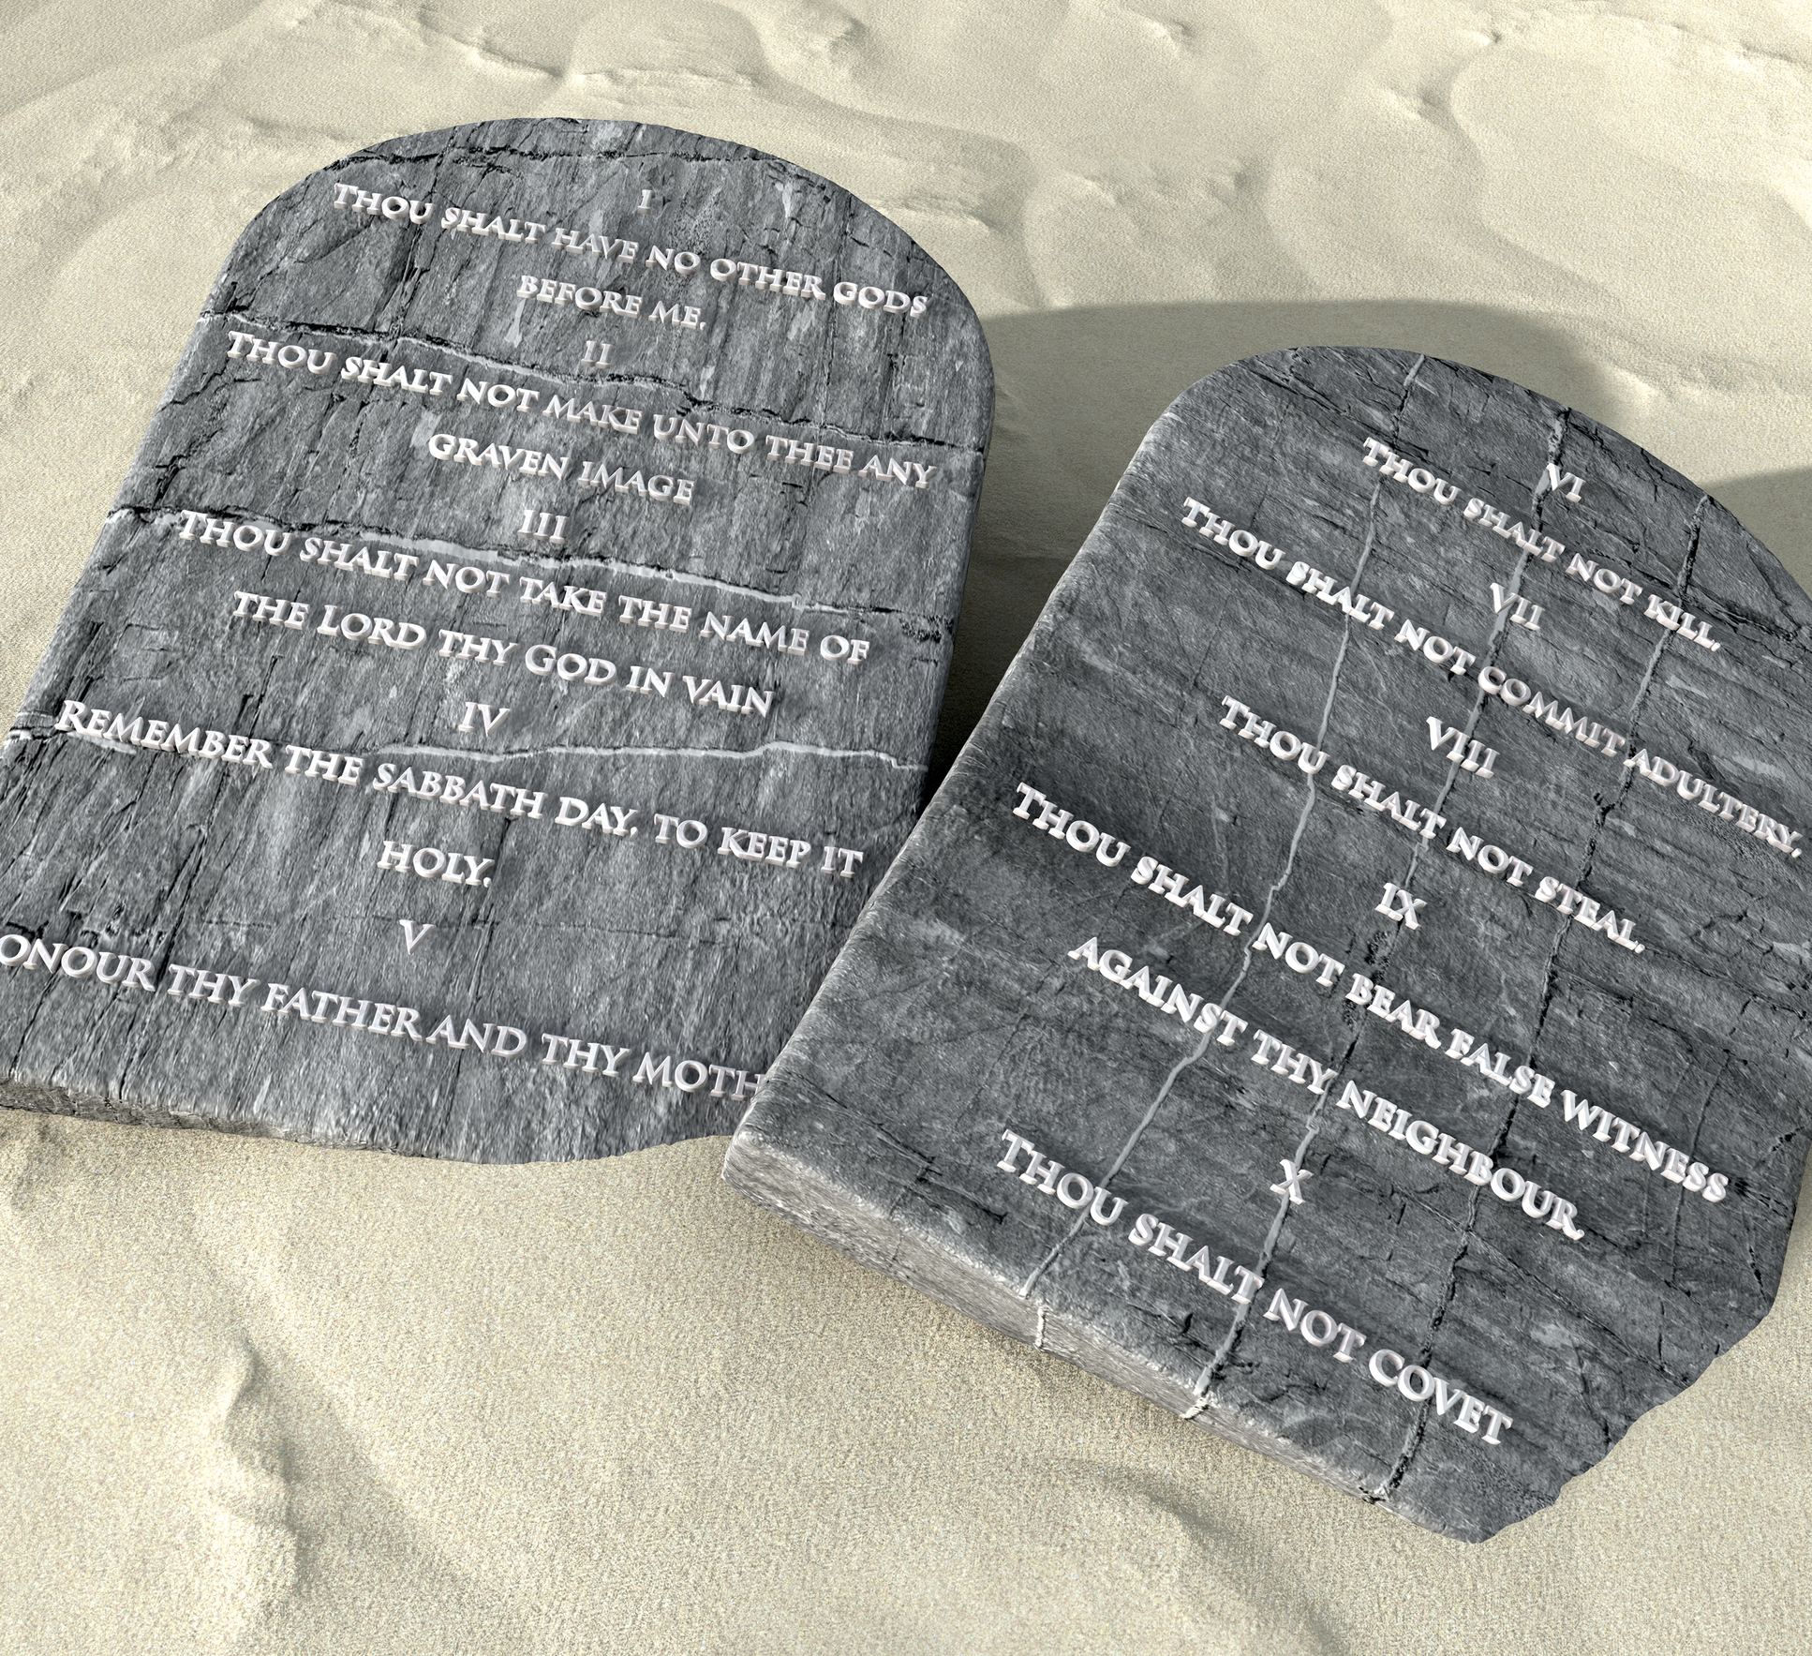
God’s commands are more than ten.
The rabbis counted 613 commandments in the Pentateuch alone.
Bringing tithes and offerings, caring for the poor, and reading Scripture are all God’s commands, but these are not listed among the Ten.

Slide 8
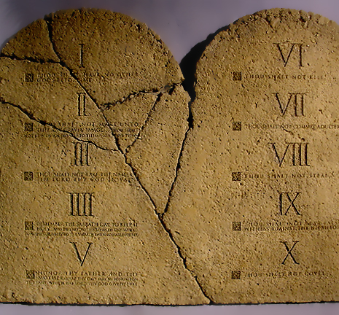
Nonetheless, the Ten Commandments encapsulate the moral principles that underpin all other commandments.

Slide 9
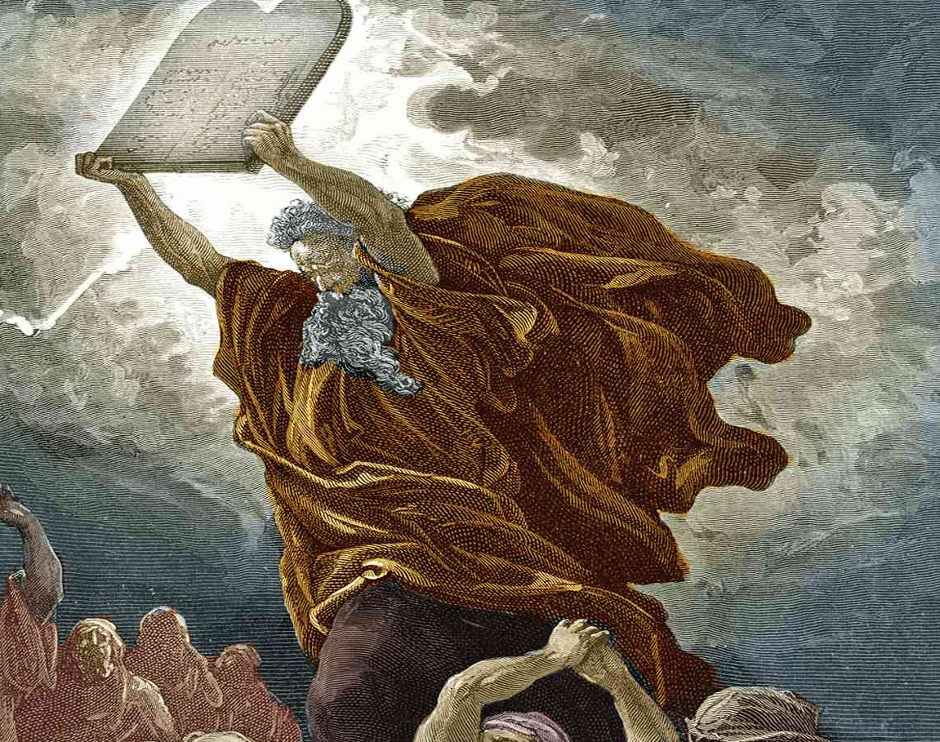
The Ten Commandments begin with the call to acknowledge the authority of the God of the Bible as the only true God, Creator, and Redeemer(Exod 20:8-11; Deut 5:12-15).
Deuteronomy 10:12-14 summarizes our duty: to “fear” God, “walk” in His ways, and “serve” Him—namely, to “keep” His commandments.

Slide 10

God’s love for us should ignite our love for Him in return, and we demonstrate this love by keeping His commandments (1 John 2:3; 3:24; 5:2).
In the covenant relationship, therefore, our faithfulness is measured by our commitment to the commandments as was the case with all faithful Bible characters such as Abraham (Gen 22:18; 26:5; Neh 9:8) and Daniel (Dan 1:8; 6:3-5, 22, 24).

Slide 11
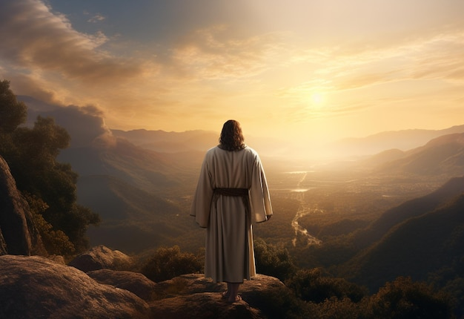
Jesus summarized the commandments into two: loving God and loving our neighbor (Matt 22:37-40).He also made references to all the Ten Commandments, confirming their continued validity for His followers (e.g., Matt 4:9; 5:17-20, 33-37; 12:8; 19:18-19).

Slide 12
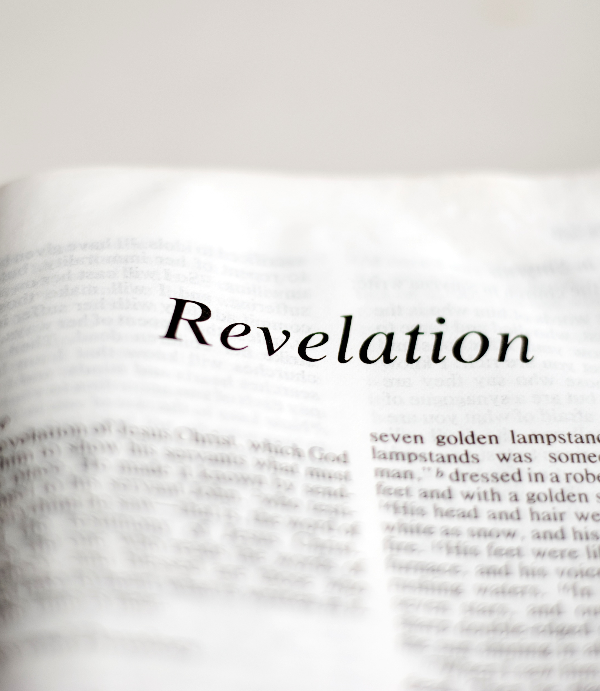
Revelation emphasizes faithfulness and its relation to the commandments.
It alludes to the Ten Commandments (e.g., Rev 13:4, 6, 14-15; 9:21; 11:19; 14:1; 21:8) and shows that obedience and endurance are integral to the believer’s relationship with God (Rev 1:9; 3:10; 14:12).

Slide 13
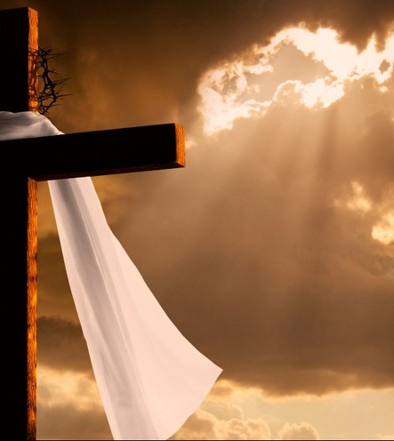
As Christ is faithful (Rev 1:5; 3:14), so His followers are to be “faithful until death” (Rev 2:10).
They are referred to as “saints” and defined as those “who keep the commandments of God and the faith of Jesus” (14:12).
The call to faithfulness is a call to a commitment to God’s commandments that shapes our character, helping us live and do good, and evidences our salvation in Christ.

Slide 14
Obedience to God’s commandments will constitute the test of faithfulness in the final crisis of earth’s history (Rev 14:6-12).
The end-time remnant is a commandment-keeping people. They keep all of God’s commandments.
And the dragon makes war with them because of their obedience (Rev 12:17).
Because faithfulness is measured by obedience to God, we are judged based on the law (Rom 2:6-24) or works (Matt 16:27; Rev 20:12-13).
It is the keeping of the commandments that distinguishes the remnant from those who follow the beast to destruction.

Slide 15

THE SABBATH

Slide 16
Many Christians believe that the Ten Commandments are normative, except for the fourth, which they think was binding only for ancient Israel.
But the Seventh-day Sabbath originated at creation (Gen 2:1-3) and was intended for all humans (Isa 56:1-7; 66:22-23; Mark 2:27).

Slide 17
Keeping the seventh-day Sabbath is the divinely designed way of acknowledging God’s authority and His sanctifying presence in our lives.
Jesus expected His followers to continue keeping the Sabbath after His ascension (Matt 24:20).
And the apostles continued to encourage Sabbath keeping (e.g., Acts 16:13; 17:2; Heb 4:9; 10:24-31).
We cannot disregard the Sabbath and still claim to keep the commandments (cf. Matt 5:19; Jas 2:8-12).

Slide 18

The first angel’s message (Rev 14:6-7) places special importance on the Sabbath commandment. When he invites everyone to “worship Him who made heaven and earth, the sea and springs of water” (v. 7), he is making a direct reference to the fourth commandment (Exod 20:11).

Slide 19
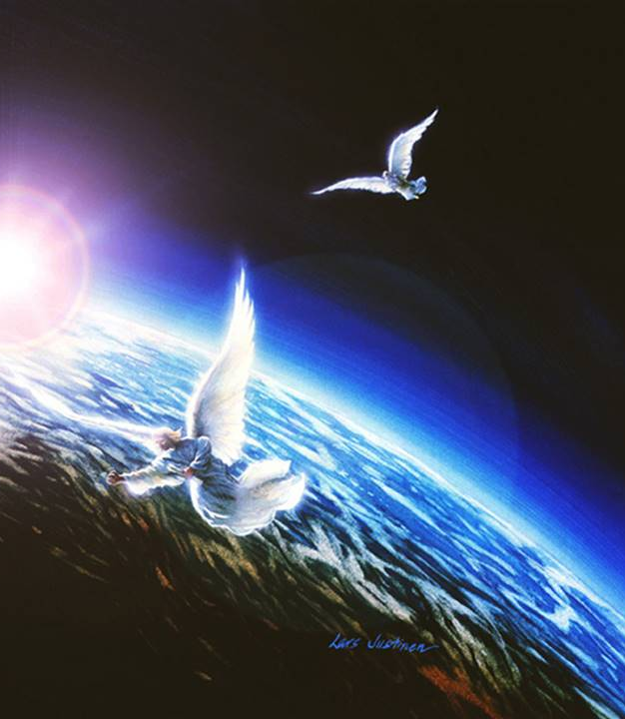
His proclamation connects worship with creation and, by his allusion to Exodus 20:11, indicates that the true worship of God to which the three angels invite the world includes observance of the seventh-day Sabbath.
As in biblical times the Sabbath was a test of loyalty (Exod 16:4, 22-30; Jer 17:21-27) and a sign between God and His people (Exod 31:12-17; Ezek 20:20), so will it be the sign of our loyalty to God in the final, end-time crisis.

Slide 20
The Sabbath commandment relates specifically to God’s authority (Exod 20:8-11), so disregarding it is tantamount to disregarding His authority over our lives (cf. Num 15:30-36). Therefore, heeding the first angel’s message is critical for our relationship with God.

Slide 21
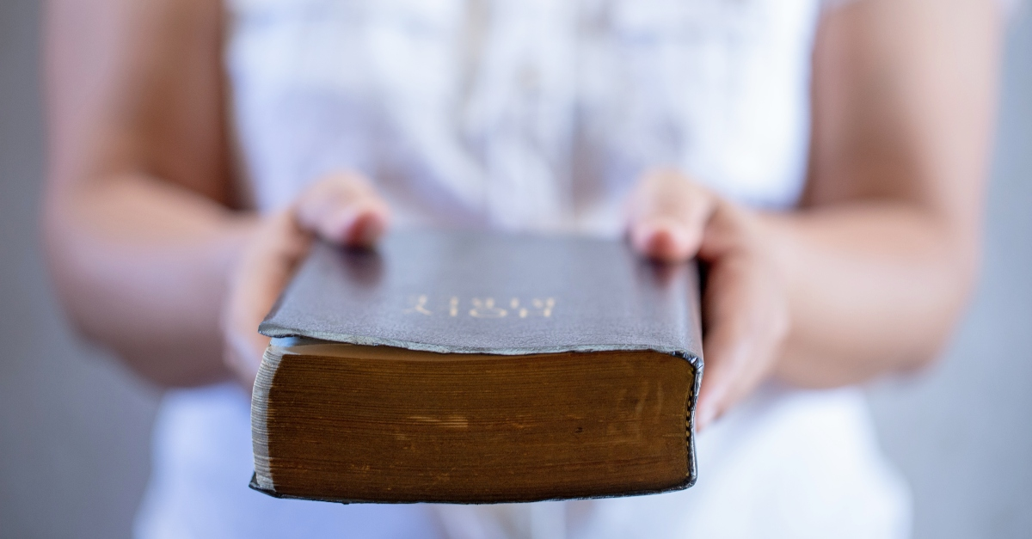
Witnessing

Slide 22
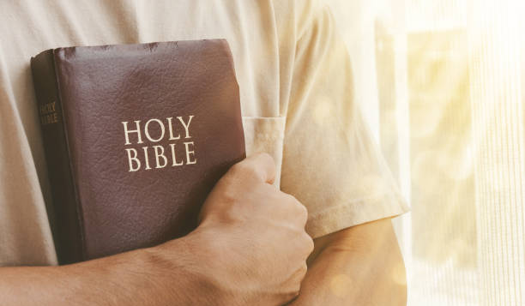
Yet the Three Angels’ Messages invite us to express our faithfulness to God not only in keeping His commandments but also in sharing the good news of salvation (Rev 14:12).
Christ Himself is the “faithful” and “true” witness (Rev 1:5; 3:14).
As Christ witnessed faithfully, so are we to witness to and about Him. In that regard, He asks us to “hold fast to My name and not deny My faith” and to be like Antipas, “My faithful witness” (Rev 2:13).

Slide 23

CONCLUSION
We can bear the fruit of faith only as we abide in Christ (John 15:1-11).
Let us continue to express our faith and salvation by keeping the commandments and confessing Christ in word and song, appearance and comportment, and behavior and service to others!

